Slide 1
Project Review
CS 346
Team 204

Slide 2
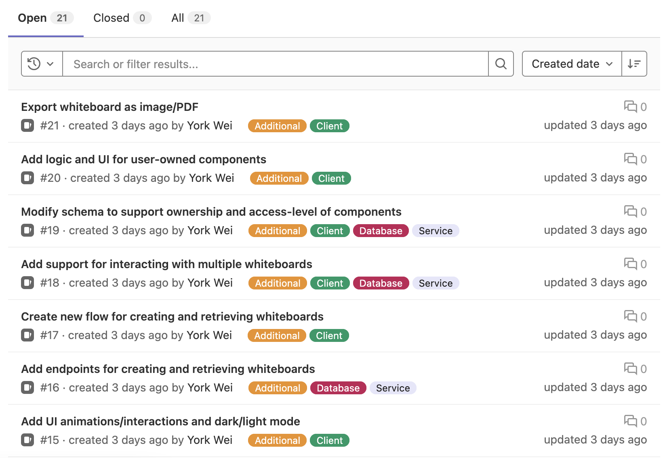
Project Requirements

Slide 3
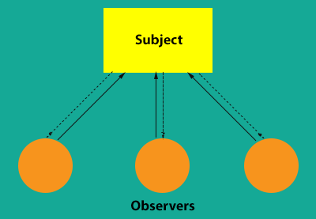
Design Patterns
Observer Design Pattern
Multiple users will be connecting to the whiteboard at once
Server will sync and publish changes to users
Decorator Design Pattern
UI will have a base window
User will have the ability to specify any combination of features.

Slide 4
User Interviews, Personas, and Extra Features

Slide 5
Risks and Mitigation
Syncing components on the whiteboard
Plan to use the server as the single source of truth
WebSocket data transfer performance
Must be mindful of data transfer size
Will use a two-level map Map<ComponentID, Map<Property, Value>> and design our own schema for data transfer
Client-side editing performance
Use an alternate data structure (kd-trees) to store coordinates of components and their size,

Slide 6
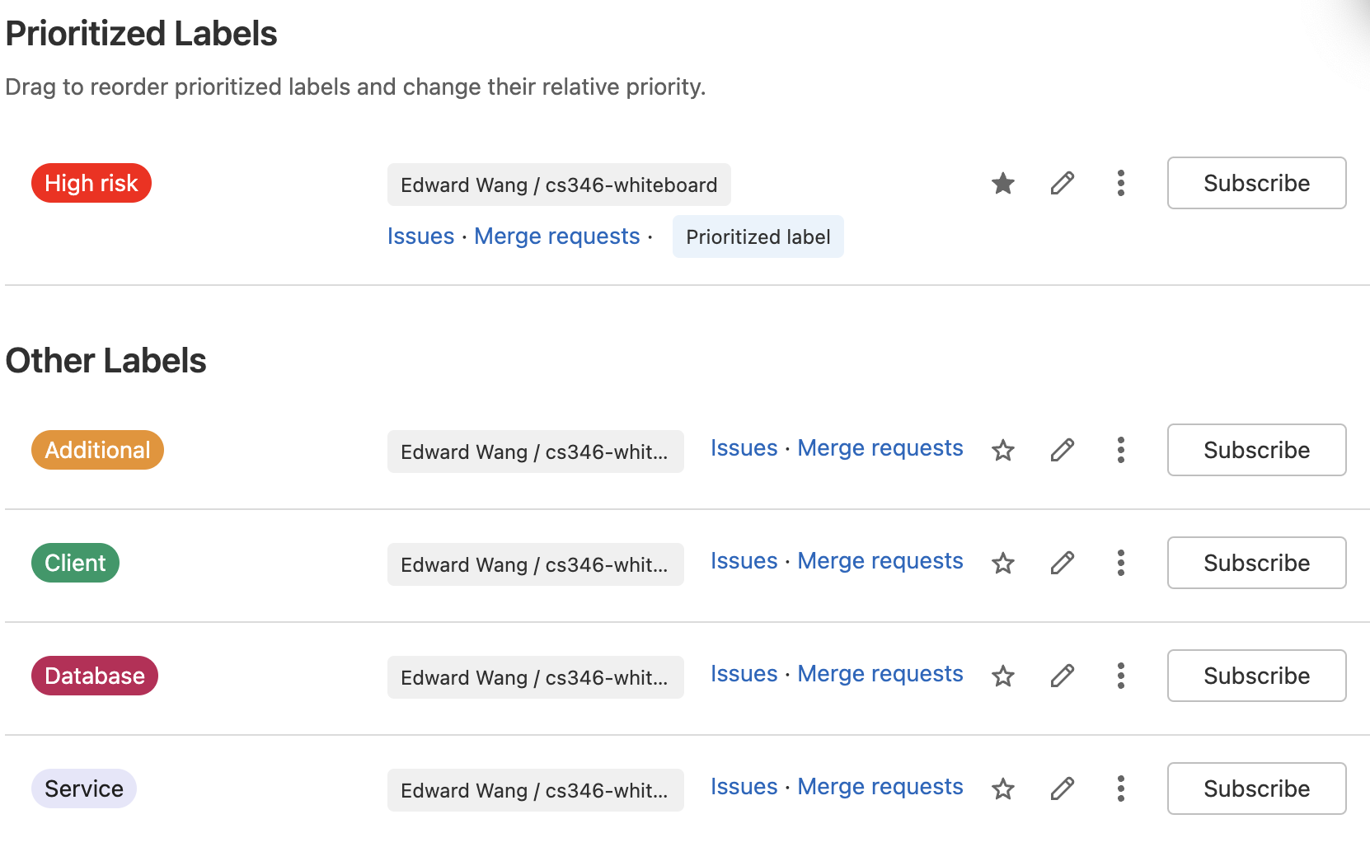
GitLab Project Setup

Slide 7
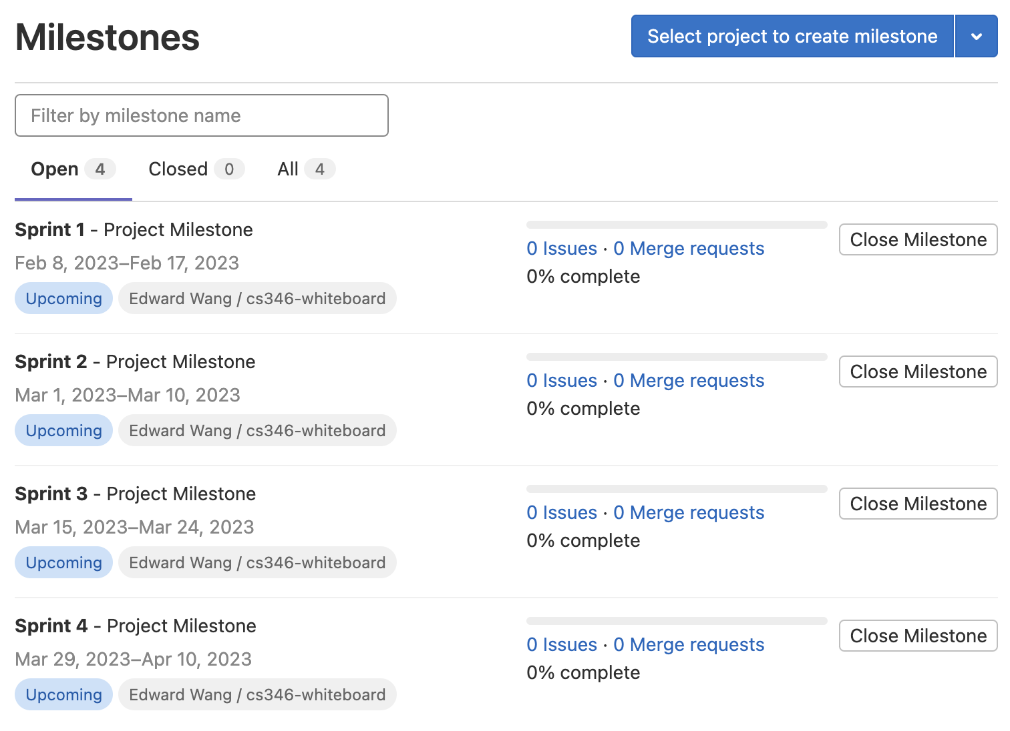
GitLab Project Setup

Slide 8
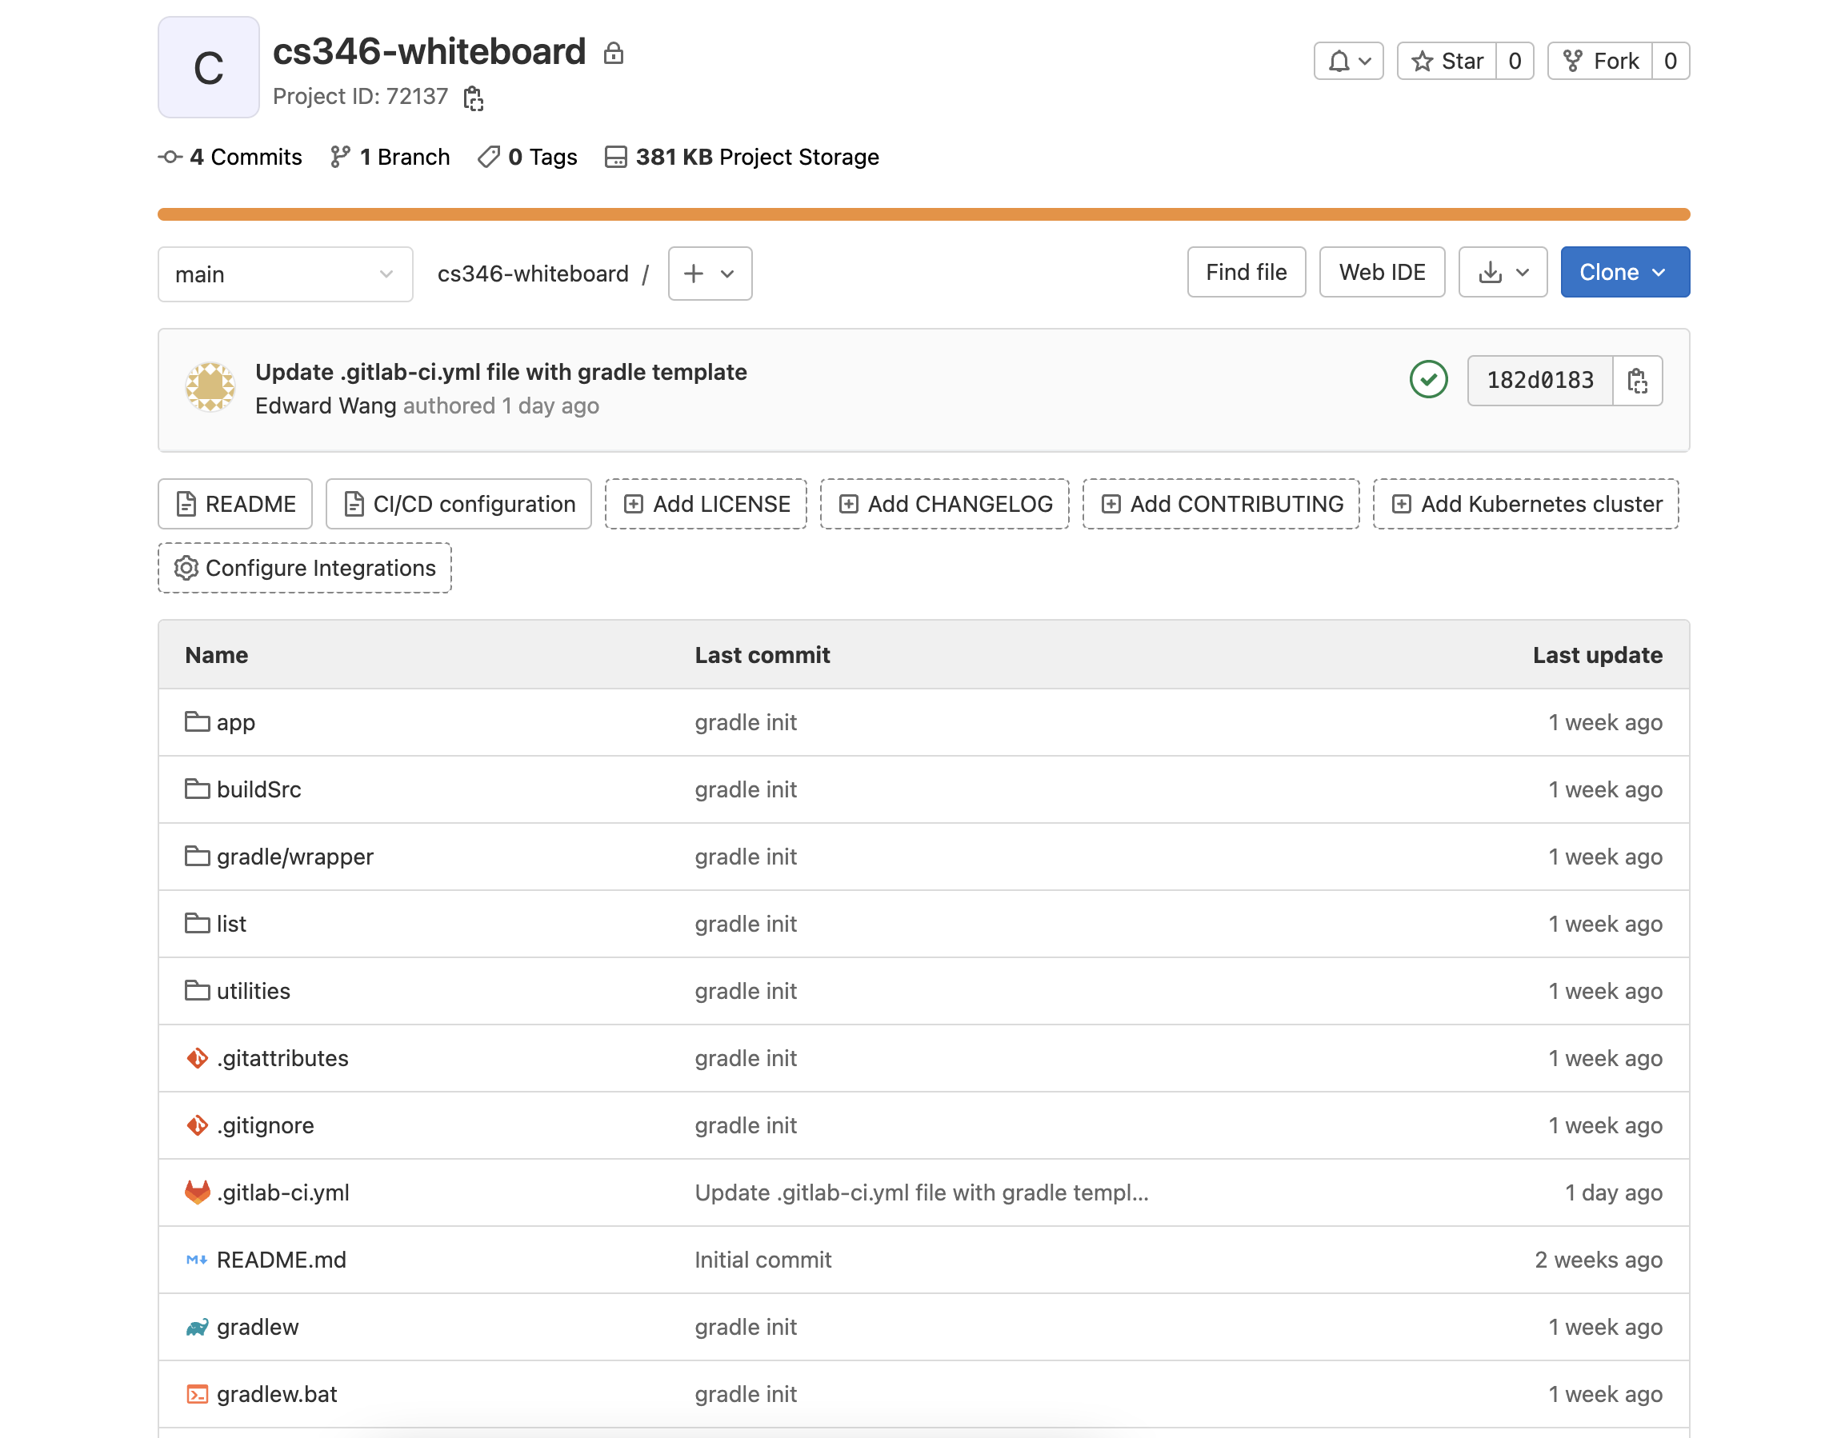
GitLab Repo

Slide 9
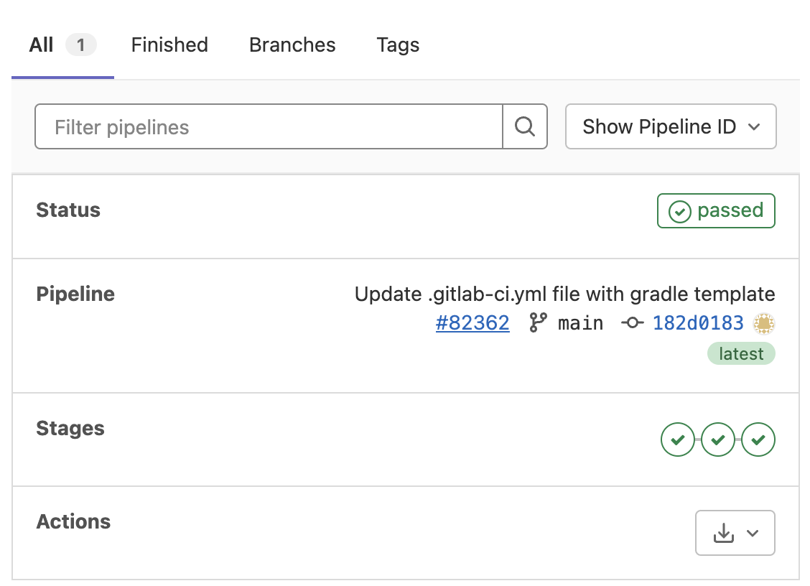
CI/CD Setup

